Slide 1
Switching and Forwarding
Outline
  Store-and-Forward Switches
  Bridges and Extended LANs
  Cell Switching
  Segmentation and Reassembly

Slide 2
Scalable Networks
Switch
  forwards packets from input port to output port
  port selected based on address in packet header
Advantages
  cover large geographic area (tolerate latency)
  support large numbers of hosts (scalable bandwidth)
T3
T3
T3
Switch
T3
STS-1
STS-1
Input
Output
ports
ports

Slide 3
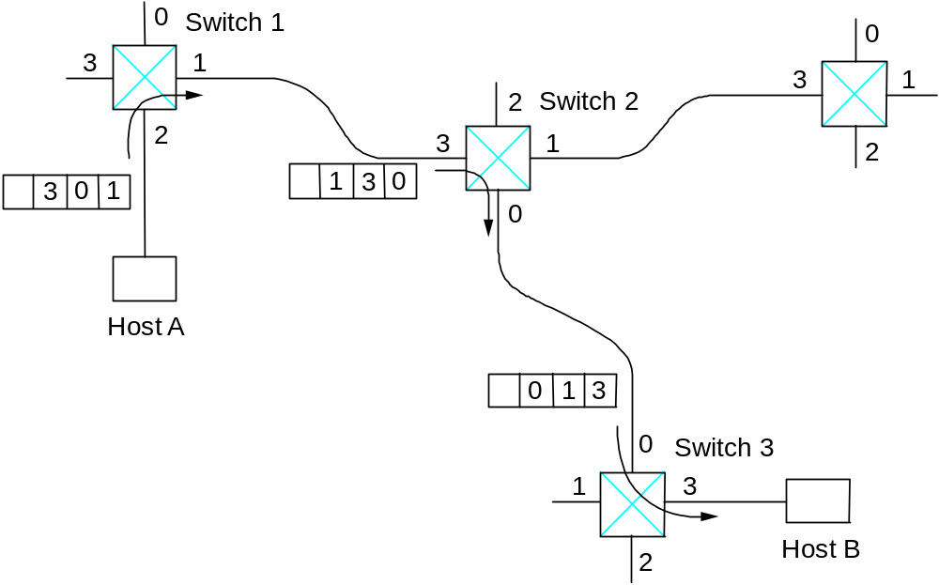
Source Routing

Slide 4
Virtual Circuit Switching
Explicit connection setup (and tear-down) phase
Subsequence packets follow same circuit
Sometimes called connection-oriented model
0
Switch 1
3
1
2
Switch 2
2
3
1
5
11
Analogy: phone call
Each switch maintains a VC table
0
Host A
7
0
Switch 3
1
3
4
Host B
2

Slide 5
Datagram Switching
No connection setup phase
Each packet forwarded independently
Sometimes called connectionless model
Host D
Analogy: postal system
Each switch maintains a forwarding (routing) table
0
Switch 1
Host E
3
1
Host F
Host C
2
Switch 2
2
3
1
0
Host A
Host G
0
Switch 3
Host B
1
3
2
Host H

Slide 6
Virtual Circuit Model
Typically wait full RTT for connection setup before sending first data packet.
While the connection request contains the full address for destination, each data packet contains only a small identifier, making the per-packet header overhead small.
If a switch or a link in a connection fails, the connection is broken and a new one needs to be established.
Connection setup provides an opportunity to reserve resources.

Slide 7
Datagram Model
There is no round trip time delay waitint for connection setup; a host can send data as soon as it is ready.
Source host has no way of knowing if the network is capable of delivering a packet or if the destination host is even up.
Since packets are treated independently, it is possible to route around link and node failures.
Since every packet must carry the full address of the destination, the overhead per packet is higher than for the connection-oriented model.

Slide 8
Bridges and Extended LANs
LANs have physical limitations (e.g., 2500m)
Connect two or more LANs with a bridge
  accept and forward strategy
  level 2 connection (does not add packet header)
Ethernet Switch = Bridge on Steroids
A
B
C
Port 1
Bridge
Port 2
X
Y
Z

Slide 9
Learning Bridges
Do not forward when unnecessary
Maintain forwarding table
Host Port
A 1
B 1
C 1
X 2
Y 2
Z 2
Learn table entries based on source address
Table is an optimization; need not be complete
Always forward broadcast frames
A
B
C
Port 1
Bridge
Port 2
X
Y
Z

Slide 10
Spanning Tree Algorithm
A
Problem: loops
Bridges run a distributed spanning tree algorithm
  select which bridges actively forward
  developed by Radia Perlman
  now IEEE 802.1 specification
B3
B
C
B5
B2
D
B7
K
E
F
B1
G
H
B6
B4
I
J

Slide 11
Algorithm Overview
Each bridge has unique id (e.g., B1, B2, B3)
Select bridge with smallest id as root
Select bridge on each LAN closest to root as designated bridge (use id to break ties)
Each bridge forwards frames over each LAN for which it is the designated bridge
A
B3
B
C
B5
B2
D
B7
K
E
F
B1
G
H
B6
B4
I
J

Slide 12
Algorithm Details
Bridges exchange configuration messages
  id for bridge sending the message
  id for what the sending bridge believes to be root bridge
  distance (hops) from sending bridge to root bridge
Each bridge records current best configuration message for each port
Initially, each bridge believes it is the root

Slide 13
Algorithm Detail (cont)
When learn not root, stop generating config messages
  in steady state, only root generates configuration messages
When learn not designated bridge, stop forwarding config messages
  in steady state, only designated bridges forward config messages
Root continues to periodically send config messages
If any bridge does not receive config message after a period of time, it starts generating config messages claiming to be the root

Slide 14
Broadcast and Multicast
Forward all broadcast/multicast frames
  current practice
Learn when no group members downstream
Accomplished by having each member of group G send a frame to bridge multicast address with G in source field

Slide 15
Limitations of Bridges
Do not scale
  spanning tree algorithm does not scale
  broadcast does not scale
Do not accommodate heterogeneity
Caution: beware of transparency

Slide 16
Cell Switching (ATM)
Connection-oriented packet-switched network
Used in both WAN and LAN settings
Signaling (connection setup) Protocol: Q.2931
Specified by ATM forum
Packets are called cells
  5-byte header + 48-byte payload
Commonly transmitted over SONET
  other physical layers possible

Slide 17
Variable vs Fixed-Length Packets
No Optimal Length
  if small: high header-to-data overhead
  if large: low utilization for small messages
Fixed-Length Easier to Switch in Hardware
  simpler
  enables parallelism

Slide 18
Big vs Small Packets
Small Improves Queue behavior
  finer-grained pre-emption point for scheduling link
    maximum packet = 4KB
    link speed = 100Mbps
    transmission time = 4096 x 8/100 = 327.68us
    high priority packet may sit in the queue 327.68us
    in contrast, 53 x 8/100 = 4.24us for ATM
  near cut-through behavior
    two 4KB packets arrive at same time
    link idle for 327.68us while both arrive
    at end of 327.68us, still have 8KB to transmit
    in contrast, can transmit first cell after 4.24us
    at end of 327.68us, just over 4KB left in queue

Slide 19
Big vs Small (cont)
Small Improves Latency (for voice)
  voice digitally encoded at 64KBps (8-bit samples at 8KHz)
  need full cell’s worth of samples before sending cell
  example: 1000-byte cells implies 125ms per cell (too long)
  smaller latency implies no need for echo cancellors
ATM Compromise: 48 bytes = (32+64)/2

Slide 20
Cell Format
User-Network Interface (UNI)
  host-to-switch format
  GFC: Generic Flow Control (still being defined)
  VCI: Virtual Circuit Identifier
  VPI: Virtual Path Identifier
  Type: management, congestion control, AAL5 (later)
  CLPL Cell Loss Priority
  HEC: Header Error Check (CRC-8)
Network-Network Interface (NNI)
  switch-to-switch format
  GFC becomes part of VPI field
4
8
16
3
1
8
384 (48 bytes)
GFC
VPI
VCI
Type
CLP
HEC (CRC-8)
Payload

Slide 21
Segmentation and Reassembly
ATM Adaptation Layer (AAL)
  AAL 1 and 2 designed for applications that need guaranteed rate (e.g., voice, video)
  AAL 3/4 designed for packet data
  AAL 5 is an alternative standard for packet data
AAL
AAL
…
…
A
TM
A
TM

Slide 22
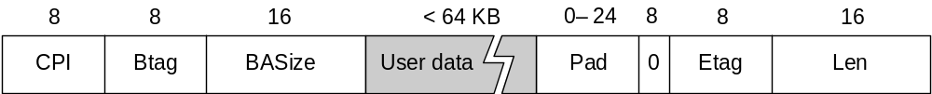
AAL 3/4
Convergence Sublayer Protocol Data Unit (CS-PDU)
  CPI: commerce part indicator (version field)
  Btag/Etag:beginning and ending tag
  BAsize: hint on amount of buffer space to allocate
  Length: size of whole PDU

Slide 23
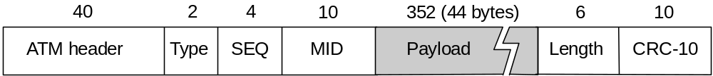
Cell Format
  Type
    BOM: beginning of message
    COM: continuation of message
    EOM end of message
  SEQ: sequence of number
  MID: message id
  Length: number of bytes of PDU in this cell

Slide 24
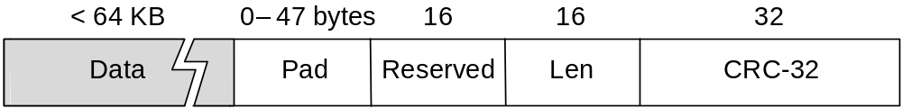
AAL5
CS-PDU Format
  pad so trailer always falls at end of ATM cell
  Length: size of PDU (data only)
  CRC-32 (detects missing or misordered cells)
Cell Format
  end-of-PDU bit in Type field of ATM header

